Slide 1
Phishing Campaign Results
An overview of the results of a phishing campaign and the vulnerability of different teams

Slide 2
HR Team
Email open rate: 100%
Phishing success rate: 75%
Email click-through rate: 85%
Interpretation: The HR team is the most vulnerable, with the highest rates across all metrics. This indicates a significant risk and a need for targeted training.

Slide 3
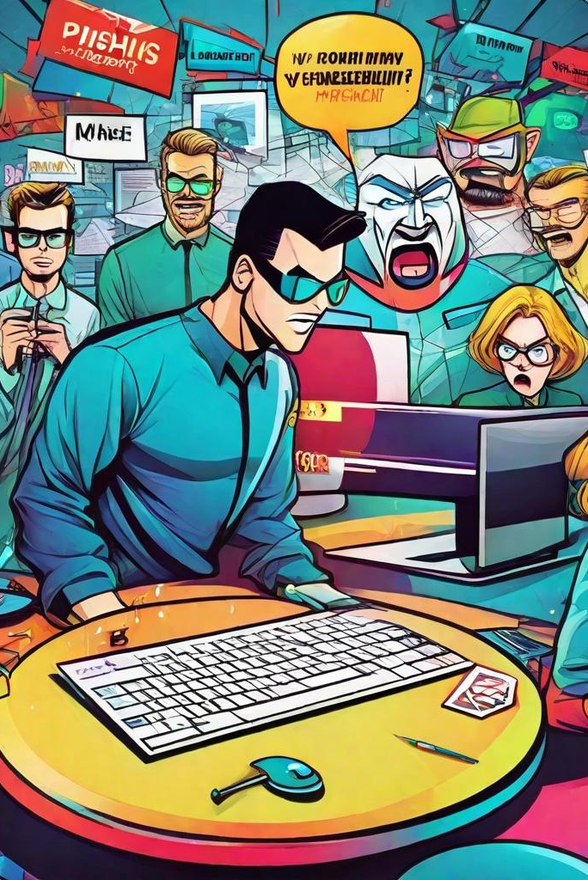
Marketing Team
Email open rate: 65%
Email click through rate: 40%
Phishing success rate: 38%
Interpretation: The Marketing team also shows high vulnerability, particularly in the clickthrough and phishing success rates.

Slide 4
Card Services Team
Phishing success rate: 10%
Email open rate: 60%
Interpretation: While the click-through rate is high, the phishing success rate is relatively low, suggesting some awareness but still a risk.
Email click-through rate: 50%

Slide 5

Engineering Team
Email open rate: 70%
Email click through rate: 4%
Phishing success rate: 1%
Interpretation: The Engineering team has a high open rate but very low click through and phishing success rates, indicating good awareness and caution.

Slide 6
IT Team
Phishing success rate: 0%
Email open rate: 80%
Email click-through rate: 2%
Interpretation: The IT team shows strong resistance to phishing, with no successful phishing attempts.

Slide 7

R&D Team
Email open rate: 50%
Email click through rate: 5%
Phishing success rate: 2%
Interpretation: The R&D team has moderate open and click through rates but a low phishing success rate.

Slide 8
Reception Team
Email open rate: 40%
Phishing success rate: 0%
Email click-through rate: 10%
Interpretation: The reception team has the lowest open rate and has had no successful phishing attempts.

Slide 9
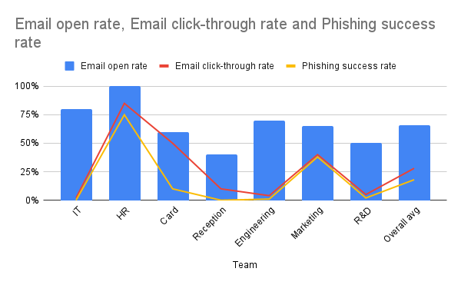
Overall Average
Email open rate: 66%
Email click through rate: 28%
Phishing success rate: 18%
Interpretation: On average, about ⅔ of the emails were opened, with a significant drop in click-through and phishing success rates. This suggests that while many employees are curious enough to open the emails, fewer are falling for the phishing attempts.

Slide 10
Key Takeaways
HR and Marketing teams are the most vulnerable and should be prioritized for additional training and awareness programs.
IT and Engineering teams show strong resistance, indicating effective training and awareness in these departments.
Card Services has a high click-through rate but a low phishing success rate, suggesting partial awareness.

Slide 11
Thank you. Please feel free to ask any questions. 😄

